Slide 1
Algorithm Analysis Big O

Slide 2
Topics
Covers of :
Asymptotic notation ( big O, big Ω, big ϴ)
Growth of Functions
Performance of Algorithms
Counting operations of an Algorithm
Time Complexity of an Algorithm
Algorithm Growth Rates

Slide 3
Why do we Analyze Algorithms
You may wonder why we pay so much attention to Algorithms and why we review them in such a great details. Some of the reason are:
Critically thinking about how algorithms work help us propose efficient solutions
Without knowing the basics and structures of algorithms and programming well, you cannot be good developers.

Slide 4
Time Complexity
The complexity of an algorithm is a measure of the amount of time and/or space required by an algorithm for an input of a given size (n).
The commonly used notation for calculating the running time complexity of the algorithm is as follows:
Big O notation: Big O is used to measure the performance or complexity of an algorithm. In more mathematical term, it is the upper bound of the growth rate of a function. if a function f(x) grows no faster than a function g(x), then f is said to be a member of O(g).
Big Ω notation: The notation Ω(n) is the formal way to express the lower bound of an algorithm's running time. It measures the best case time complexity or the best amount of time an algorithm can possibly take to complete.
Big θ notation: The notation θ(n) is the formal way to express both the lower bound and the upper bound of an algorithm's running time.

Slide 5
Asymptotic notation : big O
The complexity of an algorithm is a measure of the amount of time and/or space required by an algorithm for an input of a given size (n).
Big-O notation (O)
Let f and g be functions from the set of integers or the set of real numbers. We say that f (x) is O(g(x))
if there are constants C and k such that |f (x)| ≤ C|g(x)|
Whenever x > k. [This is read as “f (x) is big-oh of g(x).”]
The vertical bars || mean absolute value
This is because we are only interested in positive values
Note for algorithm analysis:
x will always be a positive integer
f(x) and g(x) will always be positive

Slide 6
Growth of functions
The study of behavior of functions, more specifically, growth of functions is important in performance analysis of algorithms.
Concretely: y = f(x), where x and y are both real, is a function that evaluates y at different values of x
We are interested in how does y change as we increase the value of x
For purposes of algorithm analysis, x can only have positive integer values greater than zero
This point will get clear when we start analyzing algorithms for their run time performance

Slide 7
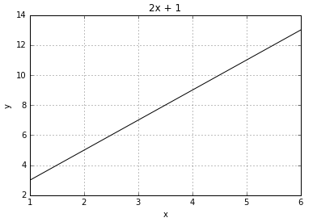
Growth of functions
Looking at the graph of y = 2x + 1 below:
y increases or grows linearly as values of x increase

Slide 8
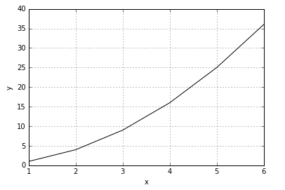
Growth of functions
Now let’s look at a graph of y = x²
y also increases here as well.
What can you observe about the graphs of the two functions:
y grows or increases as x is increased
y grows more rapidly or faster when y = x²
After x=2, values of y when the function is y= x² overtakes the function y=2x + 1.

Slide 9
Activity 1 : Fill in the following table for the function y =x³
Using the table above draw a graph of this function on paper’
Activity 2 : Given the three functions:
a) y=2x + 1 b) y =x² c ) y =x³
which function grows the fastest? For what value of x will the function y=x³ overtake the function y =2x + 1?
X | y =x³
1 | 1
2 | 8
3 | 27
4 | 64

Slide 10
We see from our previous examples that the fastest growing function may not always have the greater value of y, specially for some small values of x
We will see later in algorithm analysis that we are interested whether one function produces values of y greater than another function, even if it does so after few small values of x
x | F(x)= x² + 4 | C.G(x)=x² + x ^{C=1} | C.G(x) ^{C=2}
1 | 5 | 2 | 4
2 | 8 | 6 | 12
3 | 13 | 12 | 24
4 | 20 | 20 | 40
5 | 29 | 30 | 60
When k > 1,
c.g(x)=x² + x overtakes f(x)=x² + 4
When c =2
|f(x)| <= c |g(x)|
Where c=2
K > 1
F(x) is big O(g(x))
|f(x)| <= c |g(x)|
Where c=1
K > 4
F(x) is big O(g(x))

Slide 11
Explain the definition:
Going back to our functions f(x)= X²+4 and g(x)= X²+X from previous slide
Let C = 1 and k = 4, then:
|(f(x)| ≤ C| g(x)|, x > k → |f(x)| ≤ |g(x)|, for x > 4
This is true when x is bigger than k (the taking over point)
So we can say that f(x) is Big-O of g(x)

Slide 12
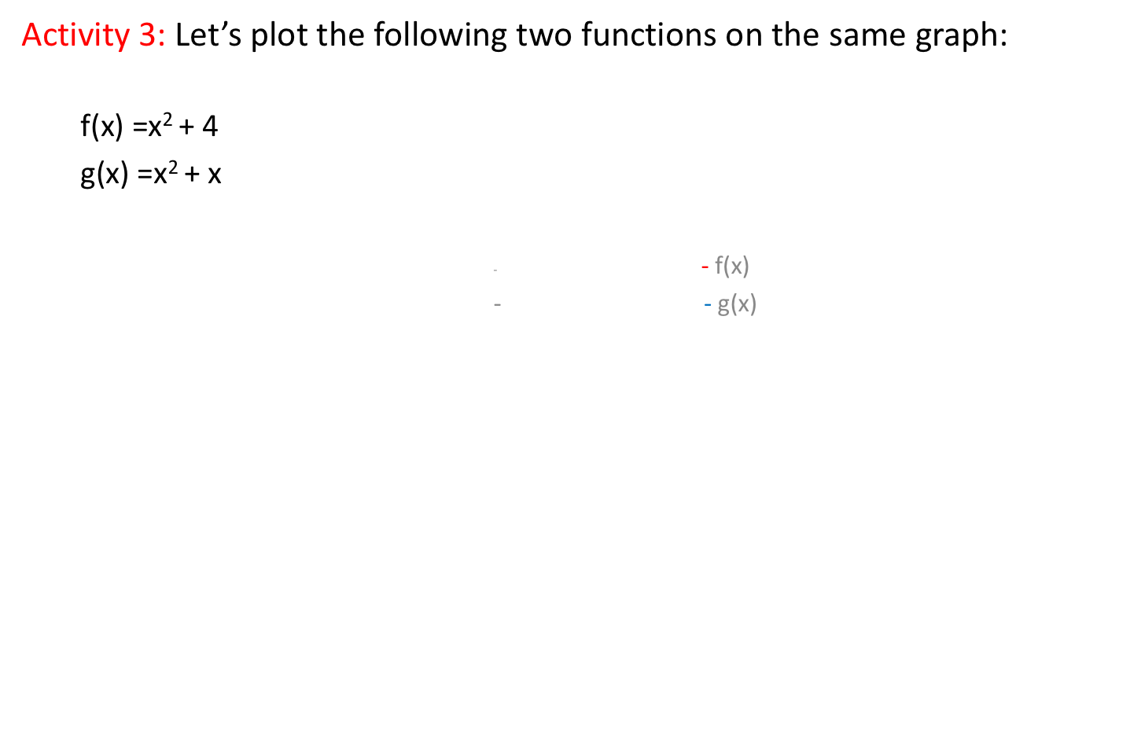
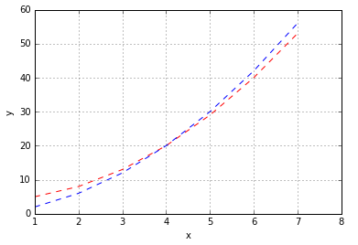

Slide 13
Growth of functions
Can we say, g(x) > f(x), for all values of x > 0?
What about when 0 < x ≤ 4?
What about when x > 4?
What we can say is:
g(x) > f(x) for all values of x > 4 OR
f(x) < g(x) for all values of x > 4
We write this mathematically as:
f(x) ≤ g(x) for x > 4

Slide 14
What if we change g(x) to g(x)=x²
For C = 1 and k >=1, we can no longer say |f(x)| ≤ |g(x)|
Therefore, f(x) is O(g(x))
x | Cg(x) C=2 | f(x) | Cg(x) C =1
1 | 2 | 5 | 1
2 | 8 | 8 | 4
3 | 18 | 13 | 9
4 | 32 | 20 | 16
5 | 50 | 29 | 25
C =2
|f(x)| <= c |g(x)| when c=2 and k>= 3
F(x) big O(g(x))
C =1
|f(x)| >= c |g(x)| when c=1 and k>= 1
F(x) big omega g(x)
F(x) big Theta g(x)

Slide 15
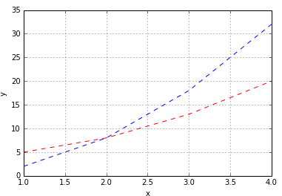
Big-O
Plot of f(x)=X²+4 and 2g(x) =2x²
- 2g(x)
- f(x)

Slide 16
Asymptotic notation: Big-Omega Ω
Big-Omega notation (Ω)
Let f and g be functions from the set of integers or the set of real numbers. We say that f (x) is Ω(g(x)) if there are positive constants C and k such
that |f (x)| ≥ C|g(x)| whenever x > k.
[This is read as “f (x) is big-Omega of g(x).”]
Notice that the difference between Big-O and Big-Omega is that
in Big-O: |f (x)| ≤ C|g(x)| and
in Big-Omega : |f (x)| ≥ C|g(x)| .

Slide 17
let’s re-visit our f(x) and g(x) functions:
f(x)= x² + 4 and g(x) = x²
This time let C=1 and k >=1
|f(x)| ≥ C|g(x)| → |f(x)| ≥ |g(x)|, for k >=1
This means f(x) is Big-Omega of g(x) or Ω(g(x))

Slide 18

What if we change g(x) to g(x)=x²
For C = 1 and k >=1, we can no longer say |f(x)| ≤ |g(x)|
Since its O(g(x)) and Ω(g(x)), then F(x) big Theta $θ(\text{g}\text{(}\text{x}\text{)}$)
x | Cg(x) C=2 | f(x) | Cg(x) C =1
1 | 2 | 5 | 1
2 | 8 | 8 | 4
3 | 18 | 13 | 9
4 | 32 | 20 | 16
5 | 50 | 29 | 25
C =1
|f(x)| >= c |g(x)| when c=1 and k>= 1
F(x) big omega g(x)

Slide 19
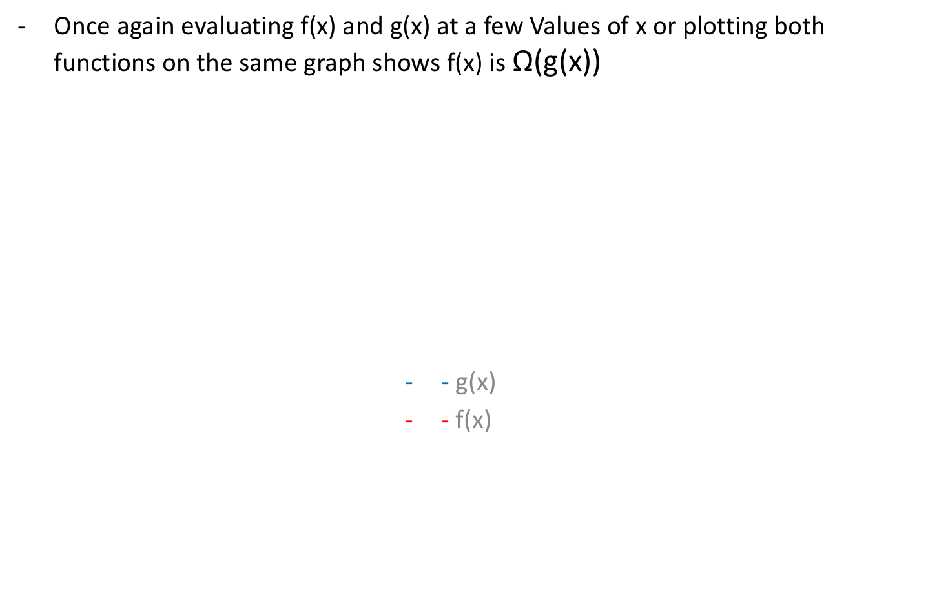
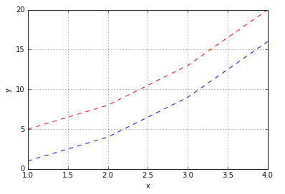
Big-Omega
x | Cg(x) C =1 | f(x)
1 | 1 | 5
2 | 4 | 8
3 | 9 | 13
4 | 16 | 20
5 | 25 | 29

Slide 20
Asymptotic notation: Big-Theta (ϴ)
Big-Theta notation (ϴ)
Let f and g be functions from the set of integers or the set of real numbers.
We say that f(x) is ϴ(g(x)) if f (x) is O(g(x)) and f (x) is Ω(g(x)).
In the example of f(x) and g(x) we have been using
f(x) =x² + 4 and g(x)=x²
We have seen that f(x) is O(g(x)) and Ω(g(x)) therefore it is ϴ(g(x))

Slide 21
Big-Theta
Notice that values for C were different:
For f(x) to be O(g(x)), C = 2 (ref. 14)
For f(x) to be Ω(g(x)), C = 1 (ref. 14)
Since C can be different for Big-O and Big-Omega we can say for f(x) to be Big-Theta of g(x)
C₁|g(x)| ≤ |f(x)| ≤ C₂|g(x)|
Continuing with our example we see:
|g(x)| ≤ |f(x)| ≤ 2|g(x)|
Plotting all three functions, f(x) =x² + 4, g(x)=x² and g(x)=2x² on the same graph we can see how f(x) lies in between functions x² and 2x²

Slide 22
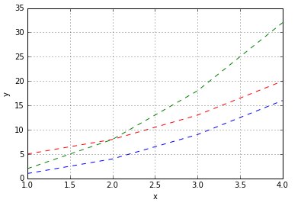
Big-Theta
- 2g(x)
- g(x)
- f(x)

Slide 23
Big-Theta
Activity: Let f(x) = x³ + x² + x and g(x) = x³ show that f(x) is ϴ(g(x)).
(Hint: find a value of C such that f(x) ≤ Cg(x).
Similarly, find a different value of C such that f(x) ≥ Cg(x).
Try C=1,2,3,4… and evaluate the functions for these values one at a time)

Slide 24

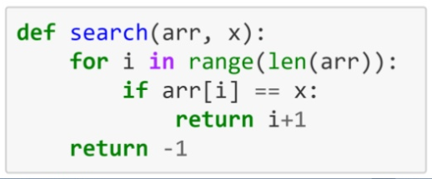
Big-Oh, Big Omega and Big Theta Comparison
To better understand Analysis of algorithm, let us consider a linear search algorithm searching the following array

Slide 25
Linear search example (cont.)
Best-case is when the number we are searching is the first element in the array (minimum number of executions). This does not give enough information. O(1)
Worst-case is when the number we are searching is the last element in the list O(n), or not in the list at all.
Therefore in Analysis of algorithm we consider always the Worst-case.

Slide 26
Comparison (Cont.)
Note also:
The Big-Oh notation represents asymptotic notation for the worst-case
The Omega (Ω) notation represents the best-case
The Theta (ϴ) notation represents the Worst-case and the best-case

Slide 27
Performance of Algorithms
To discuss how to use growth of functions to evaluate Performance of an algorithm:
Performance of an algorithm means:
How much time an algorithm will take to solve a specific problem of a specific size
We will focus on this aspect of performance in this course
How much space or memory does the algorithm need to solve a specific problem of a specific size
We will not cover this aspect of performance in this course

Slide 28
Performance of Algorithms
Performance of an algorithm depends on the type of problem and its’ size
Type of problem:
Counting number of registered students in a course vs. Sorting names of all registered students in a course.
*Counting will be lot faster than sorting
Size of problem:
Sorting names of all registered students in one course vs. Sorting names of all students in the college
*Sorting names of all students in the college will take longer

Slide 29

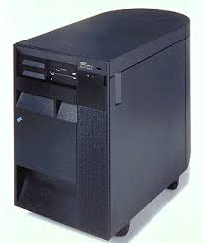
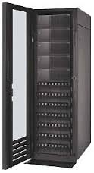

Performance of Algorithms
Run the algorithm on a computer and record the time it takes
This would depend on the computer the algorithm runs on
Laptop Desktop Server Big server
CPU: 1.4GHZx32 2.2 GHZx64 2.7 GHZx64 3.2GHZx64
RAM: 4GB 8GB 32GB 128GB
Cache: 2MB 4MB 8MB 32MB
An algorithm running on faster bigger hardware will run faster
Can we measure performance independent of hardware
Yes. We can use mathematics to find out the performance of an algorithm

Slide 30
Analysis of Algorithms
Analysis of Algorithms is the area of computer science that provides tools to analyze the efficiency of different methods of solutions.
How do we compare the time efficiency of two algorithms that solve the same problem?
How are the algorithms coded?
Comparing running times means comparing the implementations.
We should not compare implementations, because they are sensitive to programming style that may cloud the issue of which algorithm is inherently more efficient.
What computer should we use?
We should compare the efficiency of the algorithms independently of a particular computer.
What data should the program use?
Any analysis must be independent of specific data.

Slide 31
Counting operations of an Algorithm
When we analyze algorithms, we should employ mathematical techniques that analyze algorithms independently of specific implementations, computers, or data.
To analyze algorithms:
First, we start to count the number of significant operations in a particular solution to assess its efficiency.
Then, we will express the efficiency of algorithms using growth functions.

Slide 32
Operation
What do we consider as Operation in this course?
Logical operations Arithmetical Operations
>, <, !=, =, OR, NAND, +, -, / , * etc.
AND, XOR etc.
Assignment: eg. count = 5;
Comparison: eg. If count = 10 , If count < 29
If count > 10 , If count<= 10
If count>= 10
Operations within a loop
NOTE:
Work done by the computer such as calculation or logical operation should be considered as operation

Slide 33
Primitive Operations
In some books, other operations are also used. However such operations here are not considered
Such as :
Indexing an array A[5] not counted
^{Print(x) not counted}
Function calling Max(lst) not counted
Print(Max(lst) ) not counted
However, the following are counted.
Assign of a list element Marks = A[5] counted
MaxValue = Max(lst) counted

Slide 34
The Execution Time of Algorithms
Example: Simple If-Statement
Times
if (n < 0) 1
absval = -n 1
else
absval = n; 1

Slide 35
The Execution Time of Algorithms (cont.)
Example: Simple Loop
Times
i = 1; 1
sum = 0; 1
while (i <= n) n+1
i = i + 1; n
sum = sum + i n
The time required for this algorithm is proportional to n
F(n) = 3n+3 , and Time complexity is O(n)

Slide 36
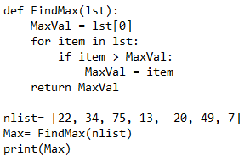
Counting Operations of an Algorithm
Now let’s look at the Max algorithm that returns the largest number from an array of numbers
On first glance we are tempted to say the algorithm takes 6 operations
- MaxVal = lst[0] // 1 assignment
- for item in lst: // (n-times) iterations
- item > MaxVal // 1 comparison (within a loop that executes n-times)
- MaxVal = item // 1 assignment (within a loop that executes n-times)

Slide 37
Counting Operations of an Algorithm
Paying closer attention we see that there is a loop that runs the following two operations repeatedly:
- if item > MaxVal // comparison
- MaxVal = lst[k] // assignment
It repeats these operations for each element in the array or for the size of the array
If the numbers arrays was:
numbers = [1, 2, 3, 4, 5, 6, 7, 8, 9, 10]
The above two operations would be repeated 10 times
So the total number of operations would be 3*10 + 3 =33
What if the arrays had 100 elements
Total number of operations would be 3*100 + 3 = 303
How many operations would the algorithm do if the size of the array was 1000?

Slide 38
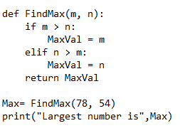
Counting Operations of an Algorithm O(1)
Let us re-visit the algorithm Max that returns the larger of two numbers
- There are five operations in the above algorithm:
if( m > n) // comparison
maxval = m // assignment
if( n > m) // comparison
maxval = n // assignment
Max = FindMax(78, 54) // assignment
So that f(n) = 5n⁰ = 5 * 1 = 5
Time complexity O (n⁰) = O(1)
No matter what m and n might be the algorithm takes a constant number of operations O(1)

Slide 39
Counting operations of an Algorithm O(n)
stuffs= ['eggs','toothbrush','kittens','mugs']
for stuff in stuffs:
print("Here's a stuff: {}".format(stuff));
Here's a stuff: eggs
Here's a stuff: toothbrush
Here's a stuff: kittens
Here's a stuff: mugs
How would you describe the efficiency of the above algorithm in Big O Notation?
For analyzing the above algorithm, you need to consider a fact or analyze how many steps this algorithm it takes. Since this for loop takes as many steps as there are elements, you need to say that the algorithm has of the efficiency of O(N) rather than O(1).

Slide 40
Counting operations of an Algorithm
def is_prime(number):
for num in range(2, number):
if number % num == 0:
return True
return False
You can determine the efficiency of the above algorithm to be O(N).
def twoForLoops(n):
for i in range(1,n):
print("Printing:"+i);
for i in range(1,100):
print("Printing:"+i);
In the above code, the complexity of the algorithm is O(N).Since the second loop does contain 100 as an argument which can be ignored because you need to express the complexity by assuming N as very large.

Slide 41
Counting operations of an Algorithm
def twoConditionalLoops(m,n):
for i in range(0,m):
print("Printing:"+i);
for i in range(0,n):
print("Printing:"+i);
There are two loops where a length of one loop is m, and the other loop length is n. Also, you need to assume m and n to be large and then the complexity of the operation is O(n+m). Since the loops are different and it takes a different input, the complexity is additive in nature.
def twoNestedForLoops(int m,int n):
for i in range(0,n):
for j in range(0,m):
print("Printing:"+(i*j));
There is a nested for loop, and again you need to assume n and m to be large, and then the complexity of the operation is O(n*m). Since the loops are the same and are nested, the complexity is multiplicative in nature.

Slide 42
Counting Operations of an Algorithm
Now let’s look at the Max algorithm that returns the largest number from an array of numbers
def Max(numbers):
max=numbers[0] # set first number to max
k = 0
while( k < len(numbers) ): # continue to search for max till end
if( numbers[k] > max ): # if current number is bigger
max = numbers[k] # set it as max
k=k+1 # go to next number in array
return max
1
2
3 stopping case for while
1
2
n
3
4
On first glance we are tempted to say the algorithm takes 6 operations
max = numbers[0] # assignment
k = 0 # assignment
k++ # assignment k++ → k = k + 1
k < len(numbers) # comparison
if( numbers[k] > max) # comparison
max = numbers[k] # assignment
F(n) = 4n + 3
n = 10 , f(10) = 4 *10 +3 = 43 , how many operations inside the loop statement ? : 40 (4*10)
How many operations outside the loop statement ? = 3
What is the total number of operations = 43

Slide 43
Counting Operations of an Algorithm
If the numbers in the list was:
numbers = [1, 2, 3, 4, 5, 6, 7, 8, 9, 10]
The above four operations would be repeated 10 times
So the total number of operations would be 4*10 + 3 = 43
What if the arrays had 100 elements
Total number of operations would be 4*100 + 3 = 403
How many operations would the algorithm do if the size of the array was 1000?

Slide 44
Counting Operations of an Algorithm
Note that number of operations the algorithm performs depends on the size of the list
This means the algorithm does not take constant time and depends on the size of the input
We will denote the size of the input by the letter n
Activity: Do the number of operations of the Linear Search algorithm depend on the size of the input? Explain your answer.

Slide 45
Performance of Algorithms: Time Complexity
The analysis done to find out the processing time or performance of algorithms is called Time Complexity analysis
Time complexity analysis involves the following general steps:
Counting number of operations of an algorithm
Expressing or writing the number of operations performed by the algorithm as a function of the input size
Analyzing the function in terms of Big-O, Big-Omega and/or Big-Theta
Expressing the Time Complexity of the algorithm using Big-Theta notation

Slide 46
Performance of Algorithms: Time Complexity
Given f(n) = 4n + 3 and g(n) = n
Activity 1: Show that that f(n) is O(g(n)) for C = 5 and k = 2 and f(n) is Ω(g(n)) for C = 1
Activity 2: In the example above we saw that f(n) was O(g(n)) and Ω(g(n))
Does this mean f(n) is ϴ(g(n))?
if f(n) is ϴ(g(n)) is true then the following inequalities hold:
C₁|g(n)| ≤ |f(n)| ≤ C₂|g(n)|
- What are the values of C₁ and C₂?

Slide 47
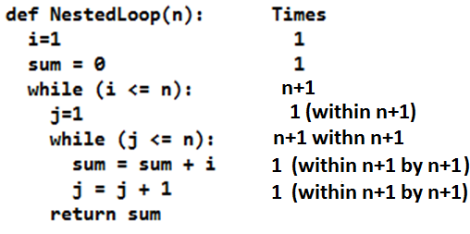
The Execution Time of Algorithms (cont.)
Example: Consider an example of Nested Loops
f(n) = 2 + (2n+1)*(3n+1) = 2 + 6n² + 2n + 3n + 1
f(n) = 6n² + 5n + 3
➔ The time required for this algorithm is proportional to n²

Slide 48
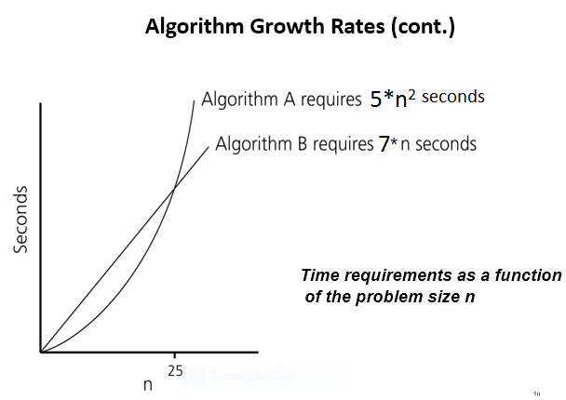
Algorithm Growth Rates (cont.)

Slide 49
Algorithm Growth Rates
We measure an algorithm’s time requirement as a function of the problem size.
Problem size depends on the application: e.g. number of elements in a list for a sorting algorithm, So, for instance, we say that (if the problem size is n).
For example:
Algorithm A requires 5*n² time units to solve a problem of size n.
Algorithm B requires 7*n time units to solve a problem of size n.
The most important thing to learn is how quickly the algorithm’s time requirement grows as a function of the problem size.
Algorithm A requires time proportional to n².
Algorithm B requires time proportional to n.
An algorithm’s proportional time requirement is known as growth rate.
We can compare the efficiency of two algorithms by comparing their growth rates.

Slide 50
General Rules for Estimation
Loops: The running time of a loop is at most the running time of the statements inside of that loop times the number of iterations.
Nested Loops: Running time of a nested loop containing a statement in the inner most loop is the running time of statement multiplied by the product of the sized of all loops.
Consecutive Statements: Just add the running times of those consecutive statements.
If/Else: Never more than the running time of the test plus the larger of running times of S1 and S2.

Slide 51
Time Complexity of Polynomail functions
Theorem: Time complexity of a polynomial: a_{m} x^{m} + a_{m-1} x^{m-1} + … + a₁ x¹ + a₀
is ϴ(n^{m}).
Example of Time complexity of algorithms with number of operations expressed as functions are given below:
- Notice that Time Complexity can be expressed as the degree of the polynomial
- m in ϴ(n^{m}) is the degree of the polynomial
- Degree of the polynomial of f(n)=5 is 0. Therefore m = 0, so ϴ(n⁰) or ϴ(1)
- Degree of polynomial of f(n)= n³ is 3. Therefore m = 3, so ϴ(n³)
function | Time Complexity
f(n)=n^{0 *}5 | ϴ(1)
f(n)= 4n + 2 | ϴ(n)
f(n)= n² + 4 | ϴ(n²)
f(n)=n³ | ϴ(n³)

Slide 52
Big-Theta
Time Complexity of some common algorithms
All algorithms with Time Complexity of the form ϴ(n^{k}) have Polynomial Complexity
Note: log is short for logarithm.
y = 10^{n} ....is equivalent to..... log₁₀(y) = n or just log y = n
Example : 100 = 10² is the same as log₁₀(100) = 2 or just log 100 = 2
Logarithm can have any base. Values change accordingly.
i.e. log₂(100) = 6.643856…
Log of a number is smaller than the number itself. Ex: log 2 < 2.
Time Complexity | Terminology | Algorithm
ϴ(log₂ (n)) | Logarithmic | Binary Search
ϴ(n) | Linear | Max
ϴ(n log n) | Linearithmic | Quick Sort
ϴ(n²) | Polynomial | Bubble Sort
ϴ(n³) | Polynomial | Matrix Multiplication

